Slide 1
The Rules of Rugby
H.E.

Slide 2
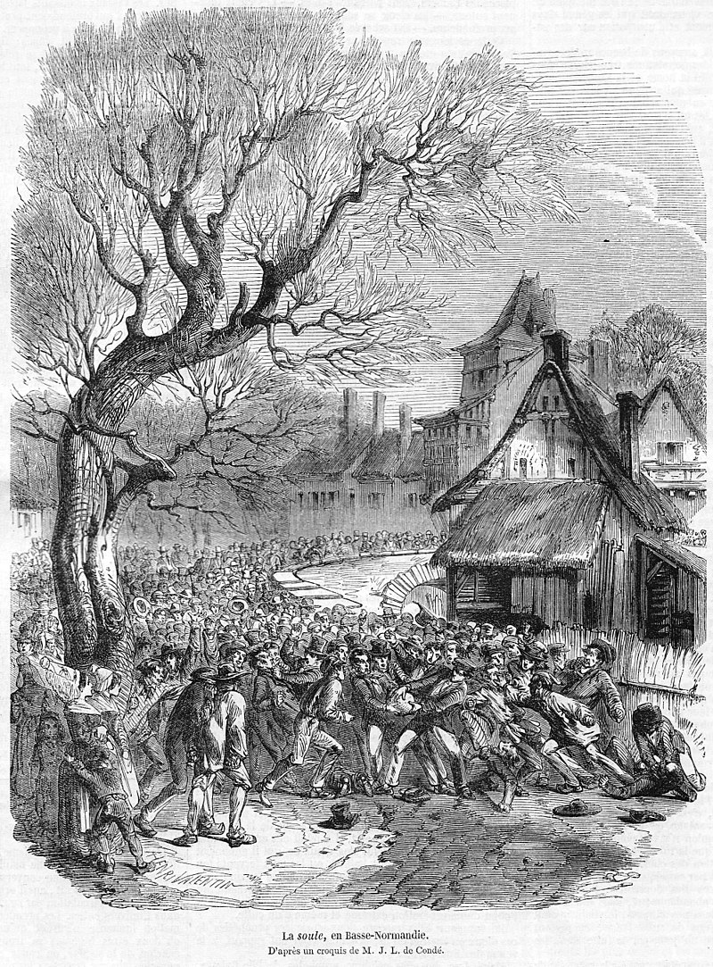
History
1823
Rugby originated at Rugby School in Rugby, England, in 1823 when during a game of football someone picked up the ball and ran with it.
1895
In 1895 rugby split into two: Rugby Union and Northern Rugby Union (later Rugby League).
1995
In 1995 Rugby Union becomes a professional sport allowing players to get paid.

Slide 3
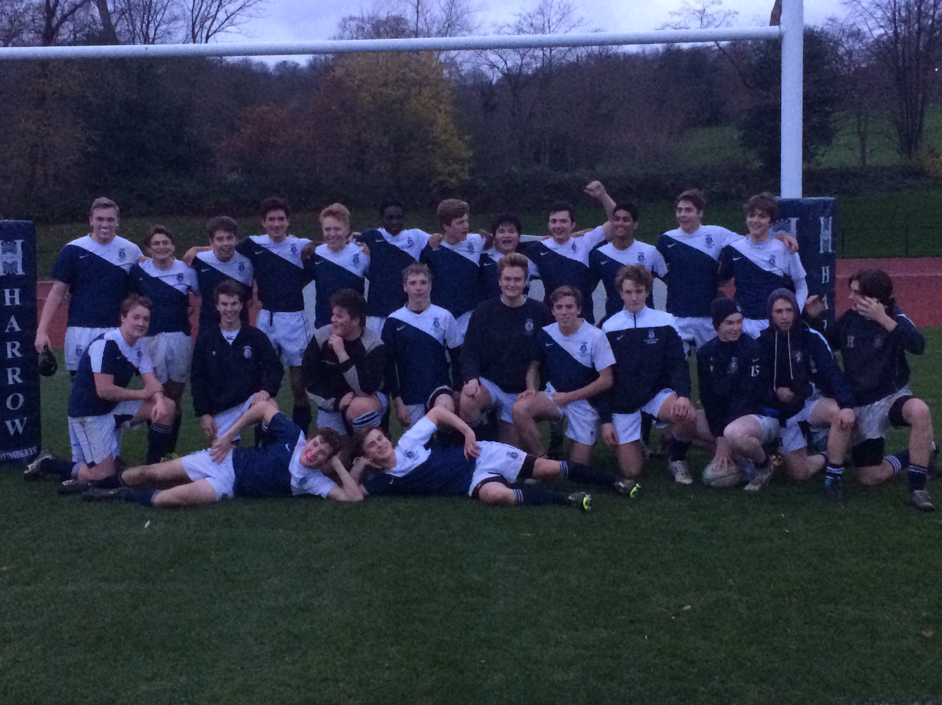
History
1823
Rugby originated at Rugby School in Rugby, England, in 1823 when during a game of football someone picked up the ball and ran with it.
1895
In 1895 rugby split into two: Rugby Union and Northern Rugby Union (later Rugby League).
1995
In 1995 Rugby Union becomes a professional sport allowing players to get paid.

Slide 4
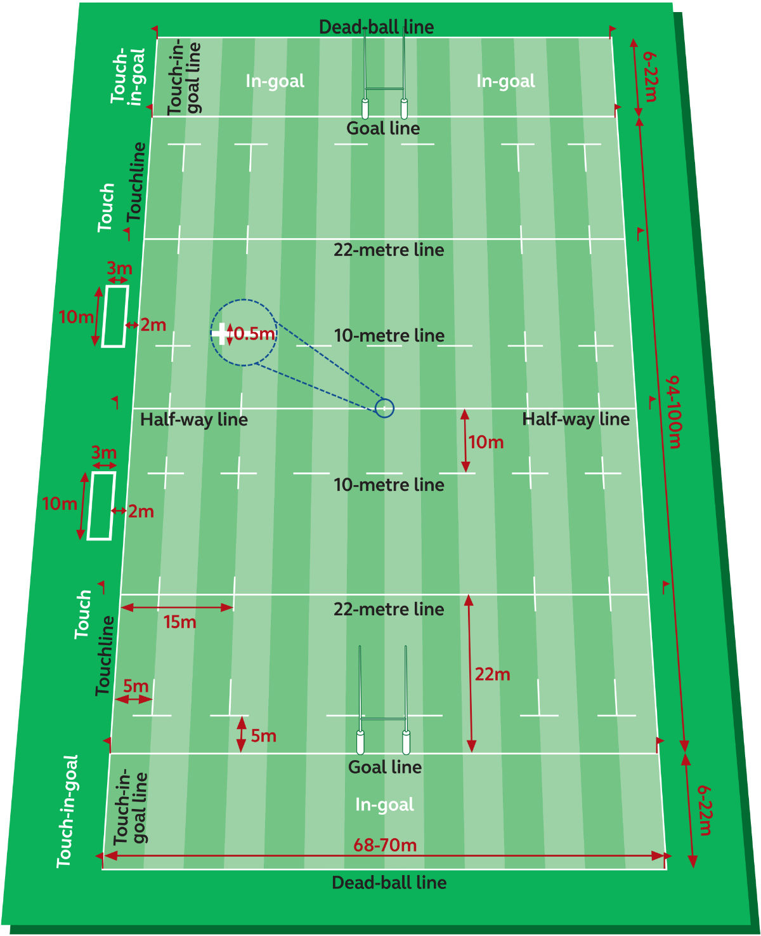
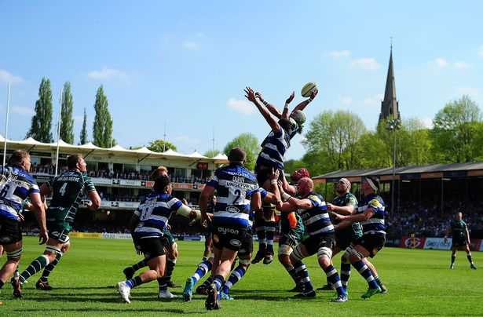
Pitch

Slide 5
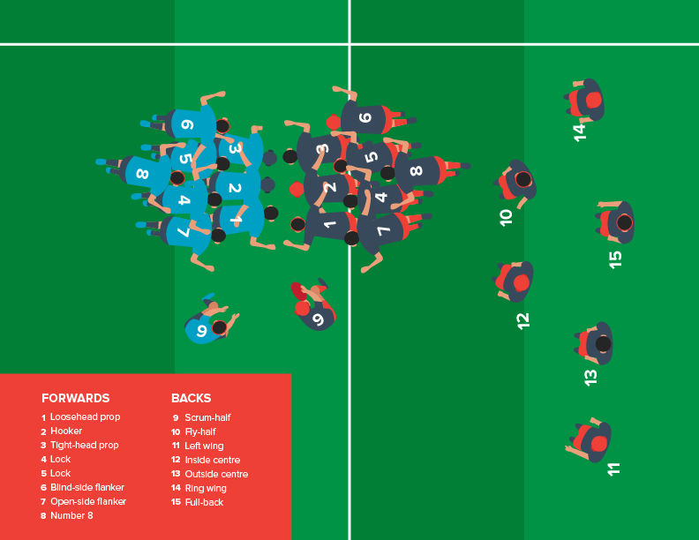
Players
The props and the hooker are called “the front row”.
In a scrum, the blind-side flanker is always positioned on the side that is closest to the touchline.

Slide 6
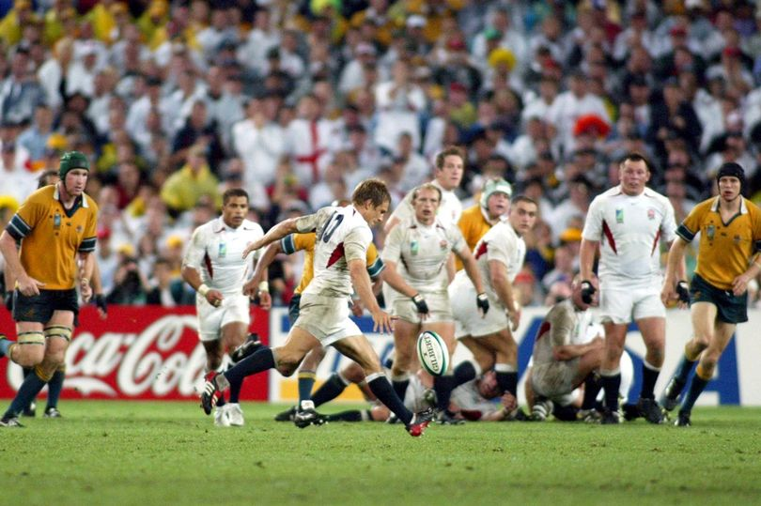
Overview
The aim is to score more points than the opposition.
A rugby match is two periods of 40 minutes each. The referee will stop the clock if needed so there is no extra time.
The game starts with a kick from the halfway line and must travel 10m from the halfway line.

Slide 7
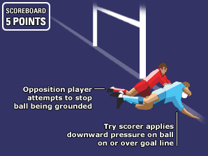
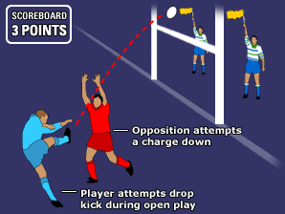
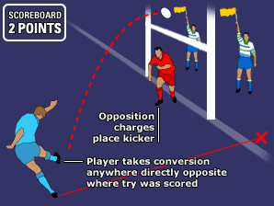
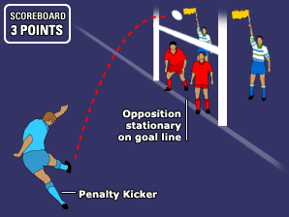
Scoring

Slide 8
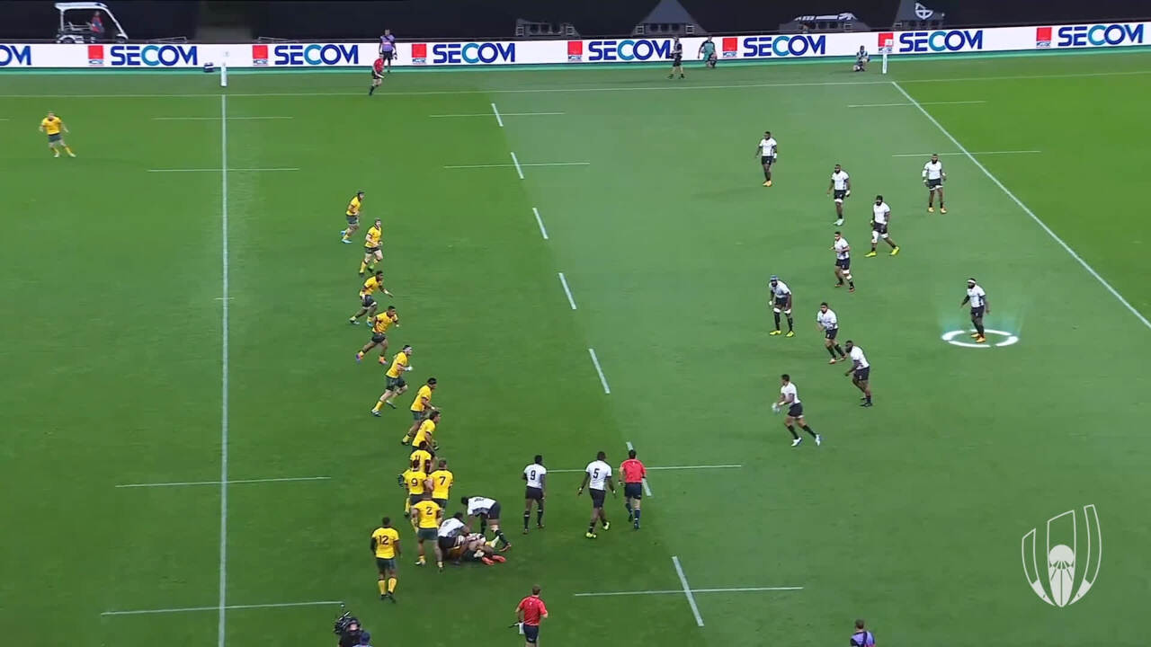
“Open Play”
Open play is when the ball is being passed or kicked between team-mates and both teams are contesting for the ball.
Passes must not go forward!
Territory is gained by either carrying the ball forwards and passing backwards or kicking.

Slide 9
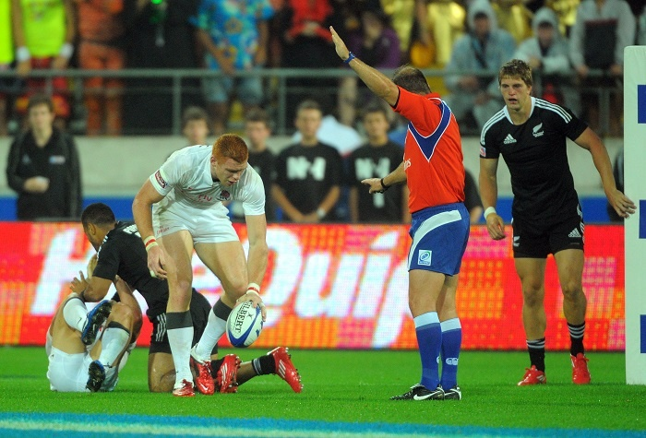
Penalties vs Free Kicks
Penalties:
Kick at goal
Kick for touch (where the kicking team gets the throw)
Scrum
Tap kick
Free Kicks:
Kick for touch (where the opposing team gets the throw)
Scrum
Tap kick

Slide 10
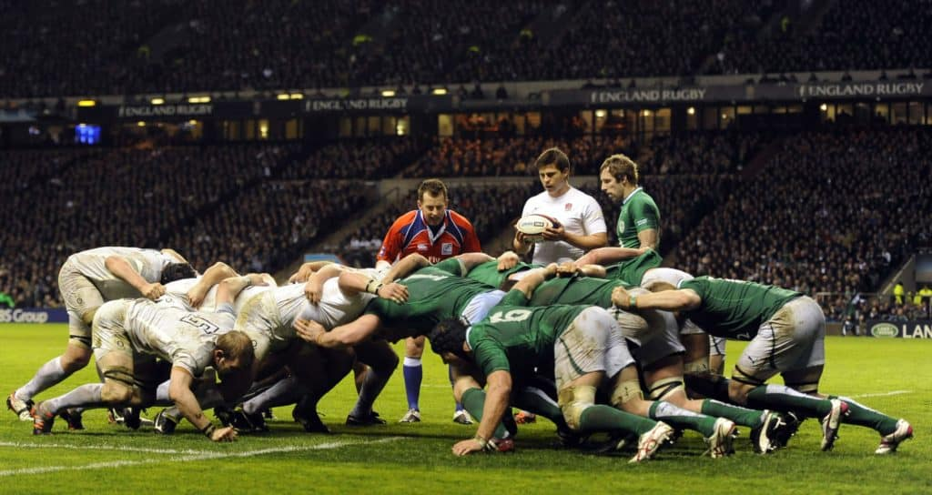
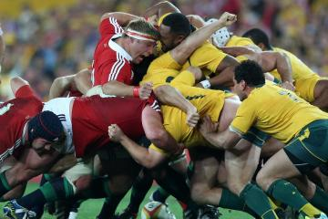
Scrummaging
Reasons for a scrum:
The ball has been knocked on
The ball has gone forward
Accidental offside
The ball has not come out from a ruck or maul
Usually this involves the eight forwards.
The front row must keep their bind. You are not allowed to break from the scrum before the ball is out.

Slide 11
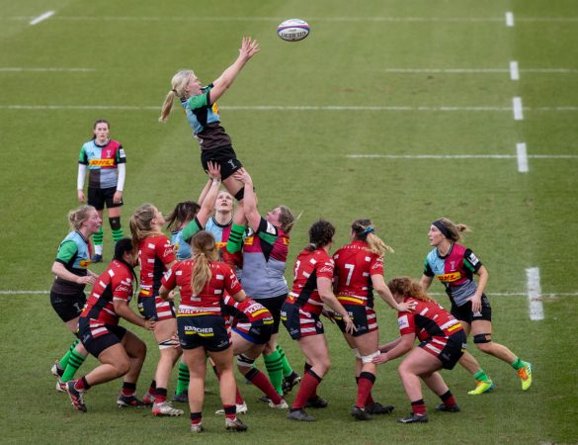
Line-out
Rules of the line-out:
The ball must be thrown straight
All players not in the line-out must be 10m behind the last man in the line
No player can use a one of the opposition to use as support when they are jumping
No player is allowed to push, charge or hold another player in the line-out
No player can be lifted before the ball is thrown
No jumper can use the outside of their arm to catch or deflect the ball

Slide 12
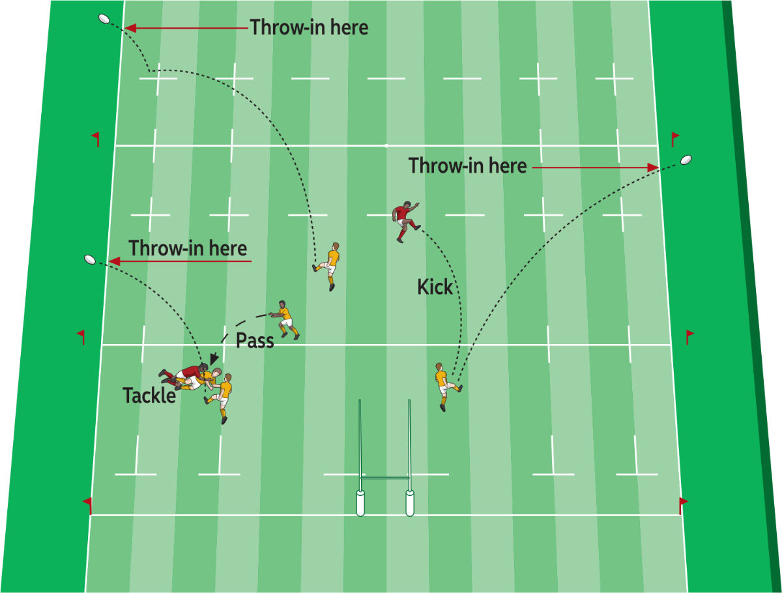
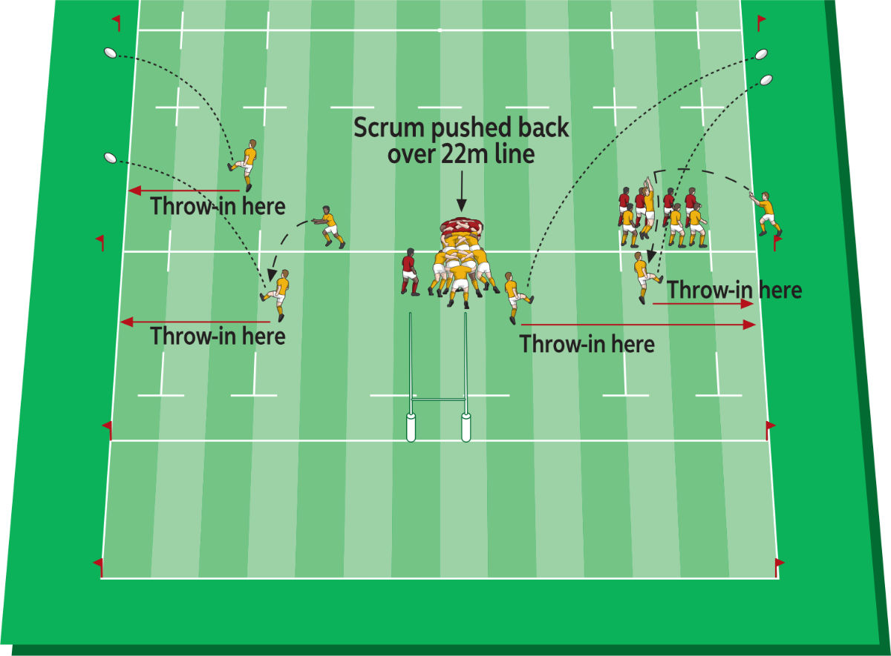
Where is the line-out?
Gain In Ground
No Gain In Ground

Slide 13
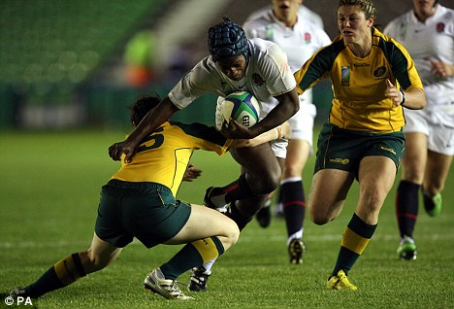
Tackling
When you tackle an opponent, you cannot make contact above the shoulders. This is for safety reasons.
Once a player in possession of the ball has been brought to ground by a tackler, they must release the ball immediately.
The tackler must release the player they have just brought down and roll away from them and the ball.
The same is true for the player who has been tackled. If they do not release the ball immediately and roll away from it, they will concede a penalty.

Slide 14
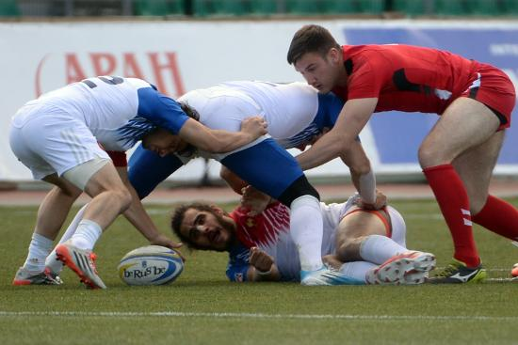
Rucks
To gain possession, both sides must try to drive over the ball to make it available for their team-mates.
Rules of the ruck:
None of the tackler's team-mates can attempt to handle or pick up the ball once the ruck has formed.
Team-mates of the tackled player can use their hands, but only if they are on their feet.
All players must join the ruck from behind the 'hindmost' foot of the last player.
They must bind with one arm round a team-mate at the very back of the ruck.

Slide 15
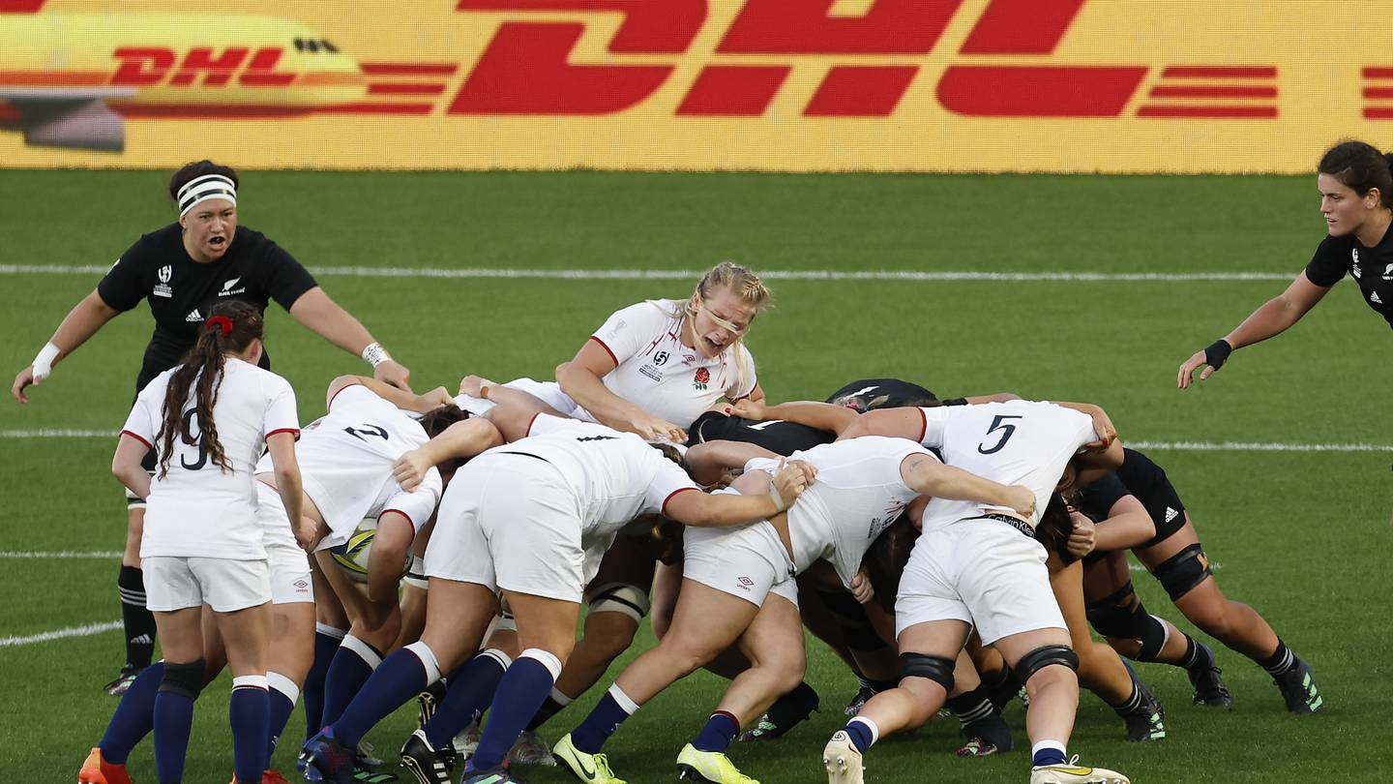
Maul
What makes the maul different to the ruck is that the ball is not on the ground but in hand.
But like the ruck, the offside line is the "hindmost" foot of the last team-mate bound to the maul.
If the maul stops moving forwards the referee will often shout "use it or lose it" to the team in possession.
This means they must pass the ball within a five-second time period.

Slide 16
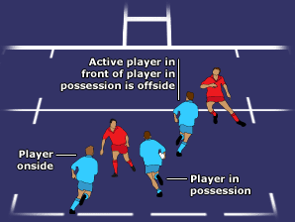
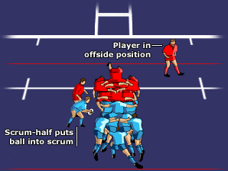
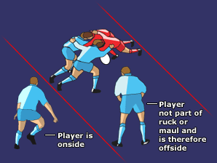
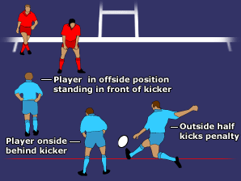
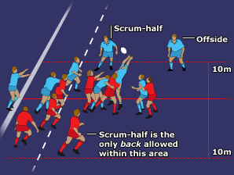
Offside

Slide 17
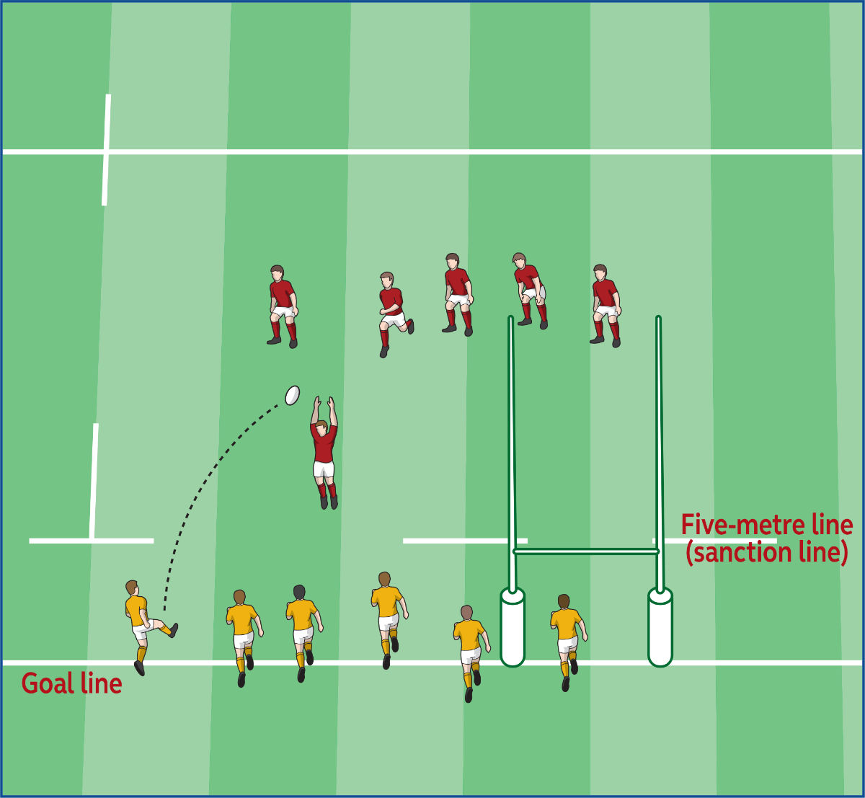
Weird Other Stuff
Drop-outs
5-metre scrum
Mark
Cards

Slide 18
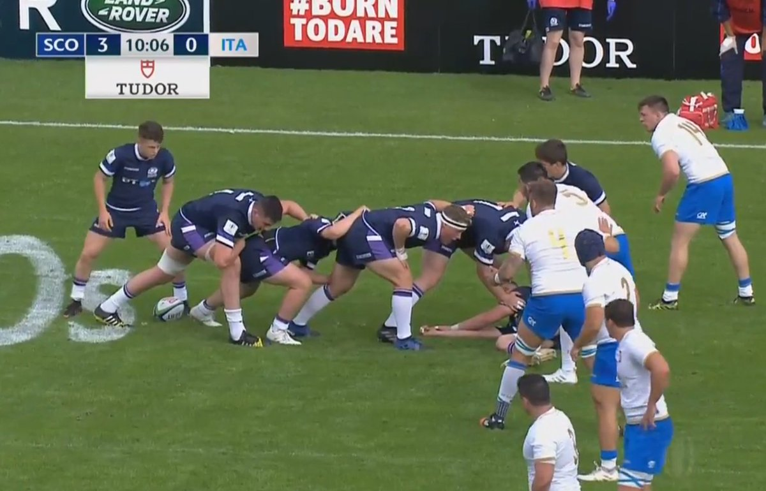
Weird Rugby Terms
Box-kick – when the scrum half kicks from the back of the ruck.
Grubber-kick – a kick that rolls along the ground.
Wheel – a scrum that has rotated through 90 degrees has wheeled.

Slide 19
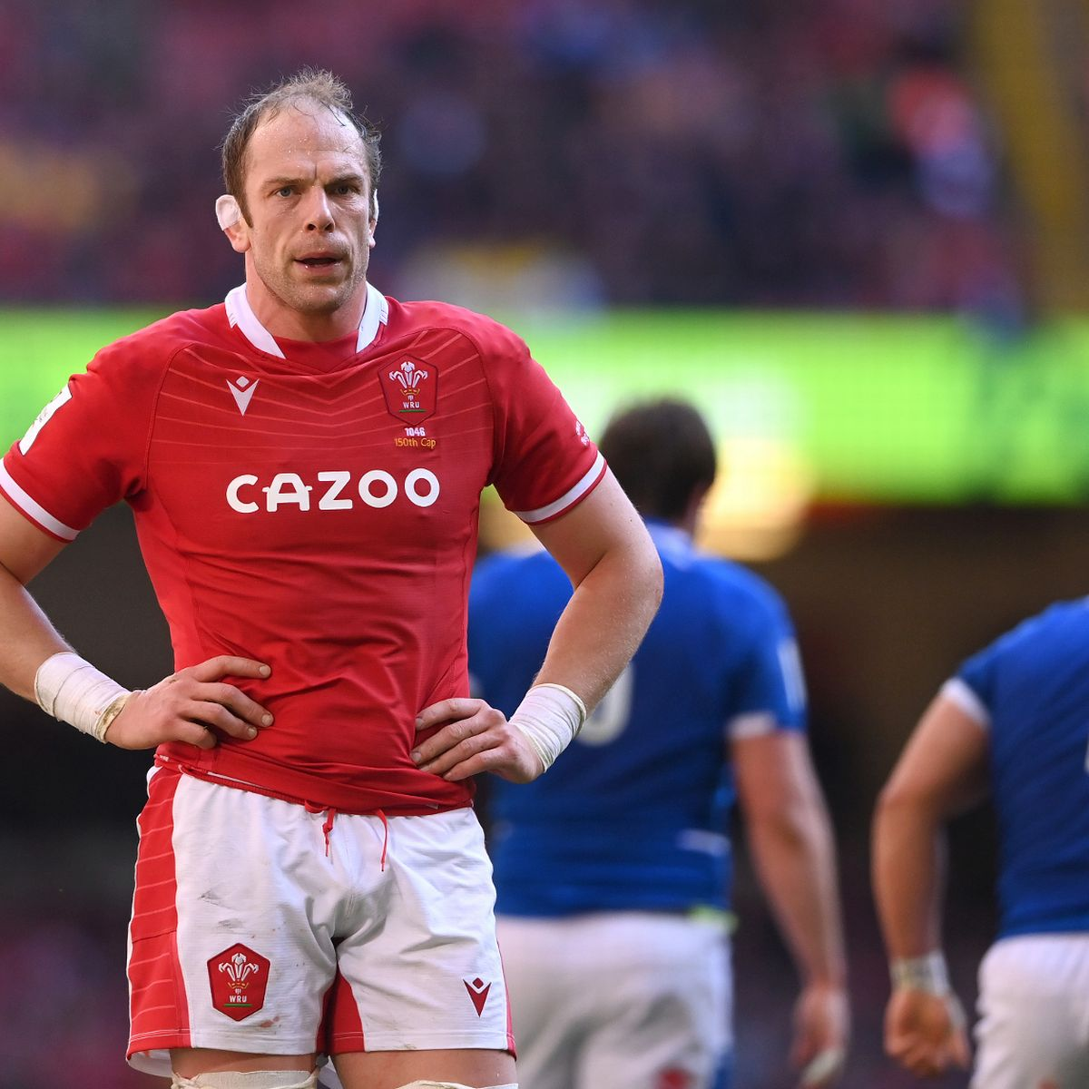

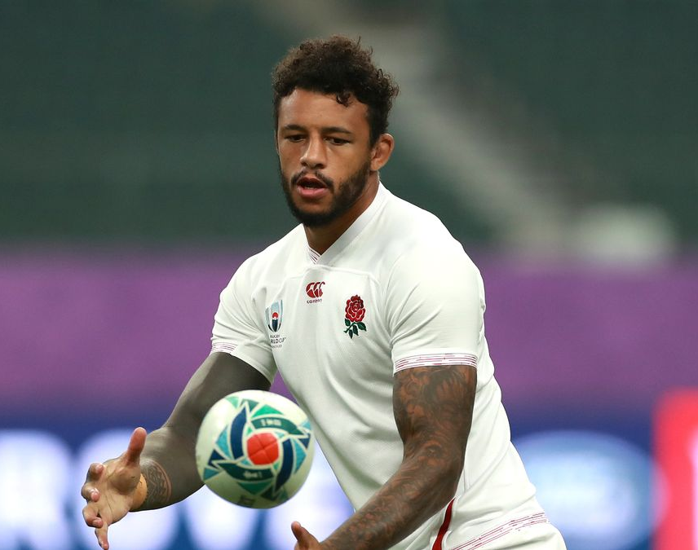
Players To Watch On Saturday
https://www.youtube.com/watch?v=GNI0_5CnX0o

